Slide 1
Chapter 7
ARP and RARP
PDF created with FinePrint pdfFactory Pro trial version www.pdffactory.com

Slide 2
Outline
ARP
ARP Package
RARP
The McGraw-Hill Companies, Inc., 2000
PDF created with FinePrint pdfFactory Pro trial version www.pdffactory.com

Slide 3
Logical Addresses
The hosts and routers are recognized at the network level by their logical addresses
A logical address is an internet address
Called a logical address because it is usually implemented in software
The logical addresses in the TCP/IP are called IP address and are 32 bits long
PDF created with FinePrint pdfFactory Pro trial version www.pdffactory.com

Slide 4
Physical Address
However, hosts/routers are recognized at the physical layer by their physical address
A physical address is an local address
Called a physical address because it is usually implemented in hardware
Examples
□ 48-bit MAC addresses in Ethernet
PDF created with FinePrint pdfFactory Pro trial version www.pdffactory.com

Slide 5
Translation
We need both the physical address and the logical address for packet delivery
Thus, we need to be able to map a logical address to its corresponding physical address and vice versa
Solutions
Static mapping
Dynamic mapping
PDF created with FinePrint pdfFactory Pro trial version www.pdffactory.com

Slide 6
Static Mapping
Create a table that associates a logical address with a physical address and store in each machine
However, physical addresses may change
A machine could change its NIC resulting in a new physical address
In some LANs, such as LocalTalk, the physical address changes every time the computer is turned on
A mobile station can move from one physical network to another, resulting in a change in its physical address
PDF created with FinePrint pdfFactory Pro trial version www.pdffactory.com

Slide 7
Dynamic Mapping
Use a protocol to find another address
ARP: Address Resolution Protocol
Map a logical address to a physical address
RARP: Reverse Address Resolution Protocol
Map a physical address to a logical address
PDF created with FinePrint pdfFactory Pro trial version www.pdffactory.com

Slide 8
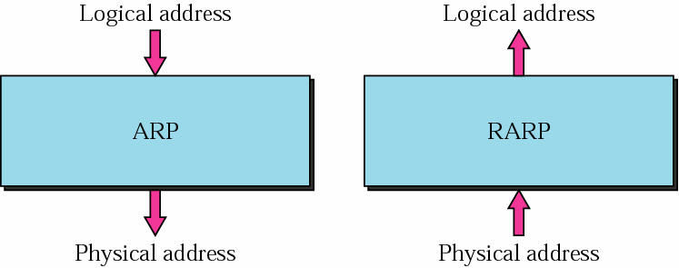
ARP and RARP
F
igure 7-1
The McGraw-Hill Companies, Inc., 2000
PDF created with FinePrint pdfFactory Pro trial version www.pdffactory.com

Slide 9
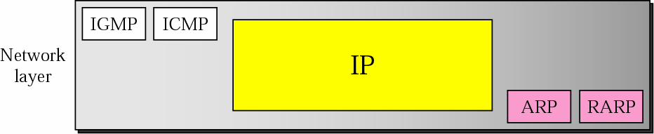
Position of ARP and RARP
in TCP/IP Protocol Suite
F
igure 7-2
The McGraw-Hill Companies, Inc., 2000
PDF created with FinePrint pdfFactory Pro trial version www.pdffactory.com

Slide 10

7.1
A R P
The McGraw-Hill Companies, Inc., 2000
PDF created with FinePrint pdfFactory Pro trial version www.pdffactory.com

Slide 11
ARP Operation
To find the physical address of another host or router on its network
Send an ARP request message
ARP request message
The physical address of the sender
The IP address of the sender
The physical address of the receiver is 0s
The IP address of the receiver
PDF created with FinePrint pdfFactory Pro trial version www.pdffactory.com

Slide 12
ARP Operation (Cont.)
Then, ARP request message is broadcast by the physical layer
For example: in Ethernet, MAC header’s destination address is all 1s (broadcast address)
Received by every station on the physical network
The intended recipient send back an ARP reply message
ARP reply message packet is unicast
PDF created with FinePrint pdfFactory Pro trial version www.pdffactory.com

Slide 13
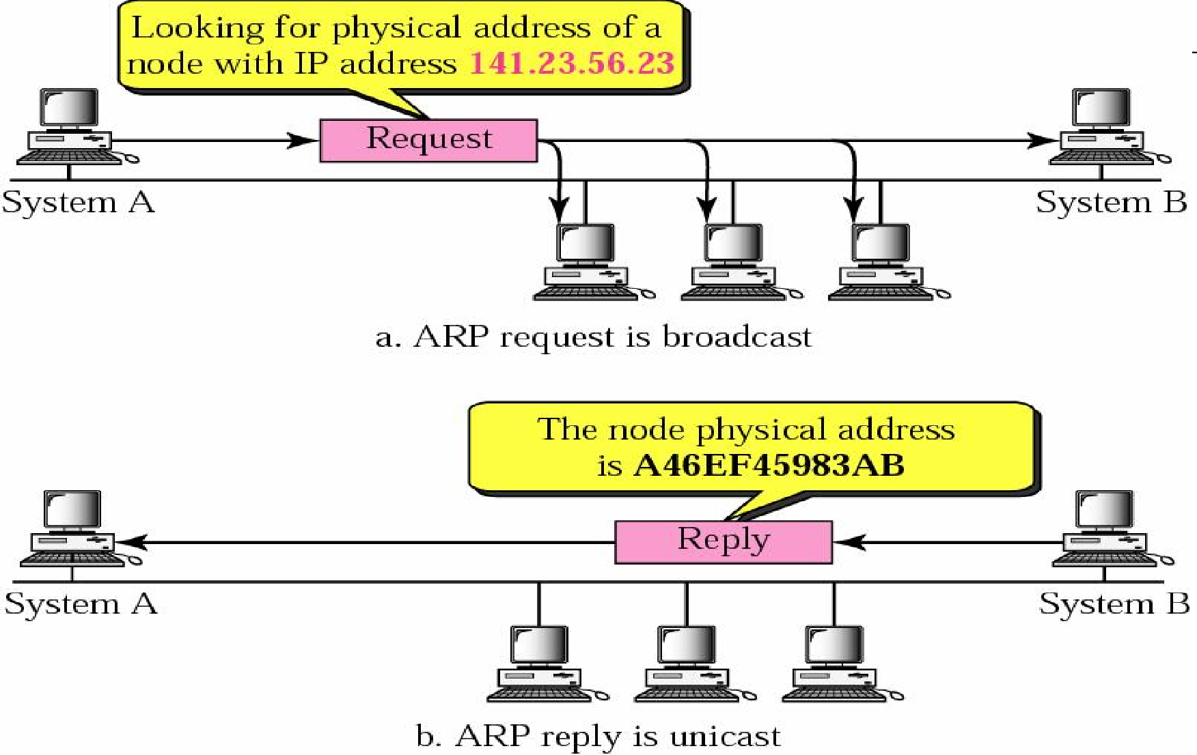
ARP Operation
F
igure 7-3
The McGraw-Hill Companies, Inc., 2000
PDF created with FinePrint pdfFactory Pro trial version www.pdffactory.com

Slide 14
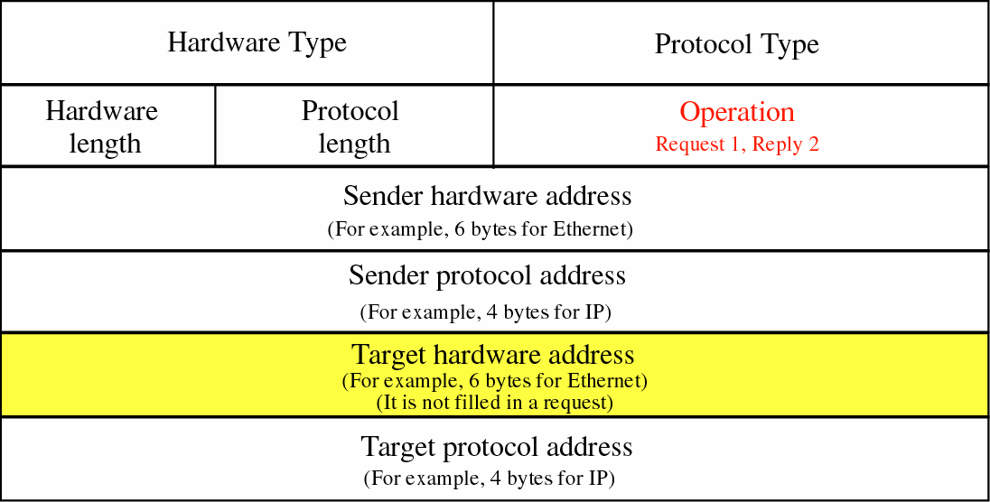
ARP Packet
F
igure 7-4
The McGraw-Hill Companies, Inc., 2000
PDF created with FinePrint pdfFactory Pro trial version www.pdffactory.com

Slide 15
Packet Format
HTYPE (Hardware type)
16-bit field defining the underlying type of the network
Ethernet is given the type 1
ARP can be used on any physical network
PTYPE (Protocol type)
16-bit field defining the protocol
□ IPv4 is 0800₁₆
ARP can be used with any higher-level protocol
PDF created with FinePrint pdfFactory Pro trial version www.pdffactory.com

Slide 16
Packet Format (Cont.)
HLEN (Hardware length)
8-bit field defining the length of the physical address in bytes
Ethernet has the value of 6
PLEN (Protocol length)
8-bit field defining the length of the logical address in bytes
IPv4 has the value of 4
OPER (Operation)
16-bit field defining the type of packet
(1) = ARP request, (2) = ARP reply
PDF created with FinePrint pdfFactory Pro trial version www.pdffactory.com

Slide 17
Packet Format (Cont.)
SHA (Sender hardware address)
A variable-length field defining the physical address of the sender
SPA (Sender protocol address)
A variable-length field defining the logical address of the sender
PDF created with FinePrint pdfFactory Pro trial version www.pdffactory.com

Slide 18
Packet Format (Cont.)
THA (Target hardware address)
A variable-length field defining the physical address of the target
For an ARP request operation packet
□ This field is all 0s
TPA (Target protocol address)
A variable-length field defining the logical address of the target
PDF created with FinePrint pdfFactory Pro trial version www.pdffactory.com

Slide 19
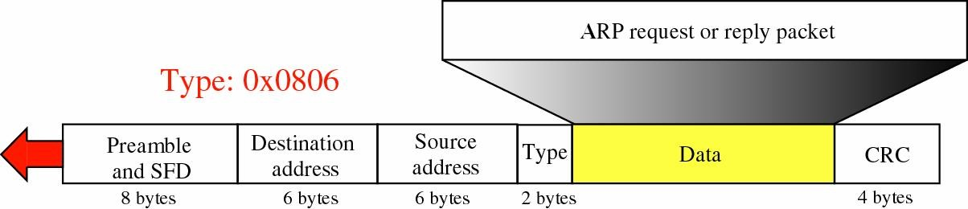
Encapsulation of ARP Packet
F
igure 7-5
An ARP packet is encapsulated directly into a data link frame
Type field indicates that the data carried by the frame is an ARP packet
The McGraw-Hill Companies, Inc., 2000
PDF created with FinePrint pdfFactory Pro trial version www.pdffactory.com

Slide 20
Operations
The sender knows the target’s IP address
IP asks ARP to create an ARP request message
The sender physical address
The sender IP address
The target physical address field is filled with 0s
The target IP address
The message is passed to the data link layer to encapsulate in a data link frame
Physical destination address is broadcast address
PDF created with FinePrint pdfFactory Pro trial version www.pdffactory.com

Slide 21
Operations (Cont.)
Every host or routers receives the frame and since the destination address is broadcast, pass it to the ARP
All machines’ ARP except the one targeted drop the packet
The target reply with an ARP reply message that contains its physical address and is unicast
The sender receives the reply message and knows the target’s physical address
PDF created with FinePrint pdfFactory Pro trial version www.pdffactory.com

Slide 22
Four Cases to Use ARP
Case 1: The sender is a host and wants to send a packet to another host on the same network
Use ARP to find another host’s physical address
Case 2: The sender is a host and wants to send a packet to another host on another network
Sender looks at its routing table
Find the IP address of the next hop (router) for this destination
Use ARP to find the router’s physical address
PDF created with FinePrint pdfFactory Pro trial version www.pdffactory.com

Slide 23
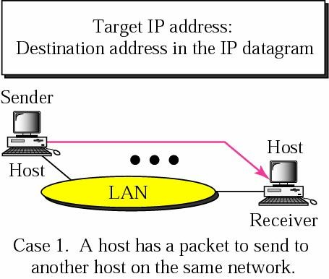
Four Cases Using ARP: Case 1
F
igure 7-6:a
The McGraw-Hill Companies, Inc., 2000
PDF created with FinePrint pdfFactory Pro trial version www.pdffactory.com

Slide 24
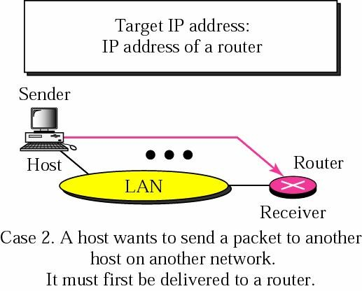
Four Cases Using ARP: Case 2
F
igure 7-6:b
The McGraw-Hill Companies, Inc., 2000
PDF created with FinePrint pdfFactory Pro trial version www.pdffactory.com

Slide 25
Four Cases to Use ARP (Cont.)
Case 3: the sender is a router and received a datagram destined for a host on another network
Router check its routing table
Find the IP address of the next router
Use ARP to find the next router’s physical address
Case 4: the sender is a router that has received a datagram destined for a host in the same network
Use ARP to find this host’s physical address
PDF created with FinePrint pdfFactory Pro trial version www.pdffactory.com

Slide 26
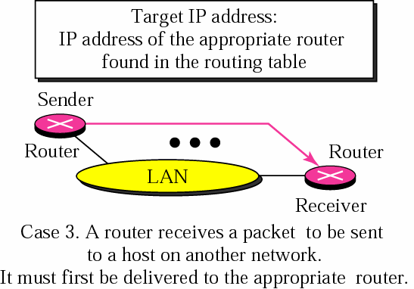
Four Cases Using ARP: Case 3
F
igure 7-6:c
The McGraw-Hill Companies, Inc., 2000
PDF created with FinePrint pdfFactory Pro trial version www.pdffactory.com

Slide 27
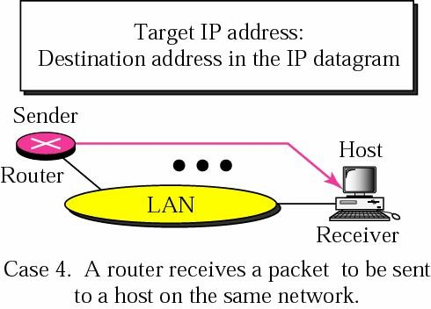
Four Cases Using ARP: Case 4
F
igure 7-6:d
The McGraw-Hill Companies, Inc., 2000
PDF created with FinePrint pdfFactory Pro trial version www.pdffactory.com

Slide 28

An ARP request is broadcast;
an ARP reply is unicast.
The McGraw-Hill Companies, Inc., 2000
PDF created with FinePrint pdfFactory Pro trial version www.pdffactory.com

Slide 29
Example 1
A host with IP address 130.23.43.20 and physical address 0xB23455102210
Another host with IP address 130.23.43.25 and physical address 0xA46EF45983AB.
The two hosts are on the same Ethernet network
Show the ARP request and reply packets encapsulated in Ethernet frames
PDF created with FinePrint pdfFactory Pro trial version www.pdffactory.com

Slide 30
Solution
Figure 7.7 shows the ARP request and reply packets
Note that
The IP addresses are shown in hexadecimal
PDF created with FinePrint pdfFactory Pro trial version www.pdffactory.com

Slide 31
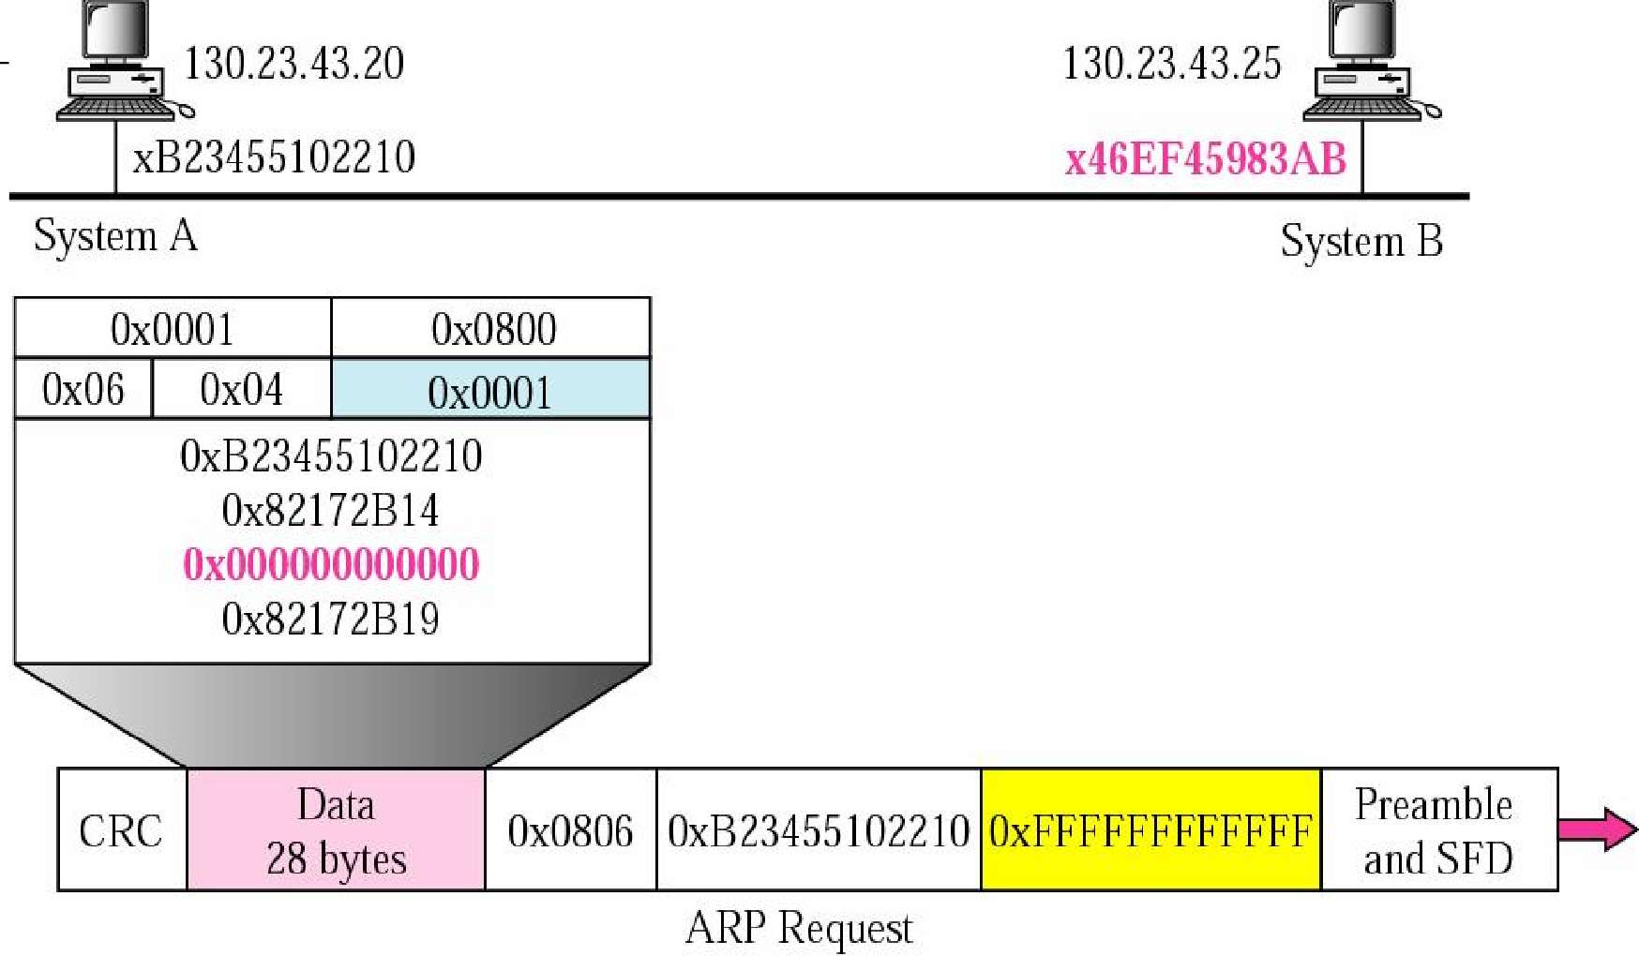
Example 1
F
igure 7-7: request
The McGraw-Hill Companies, Inc., 2000
PDF created with FinePrint pdfFactory Pro trial version www.pdffactory.com

Slide 32
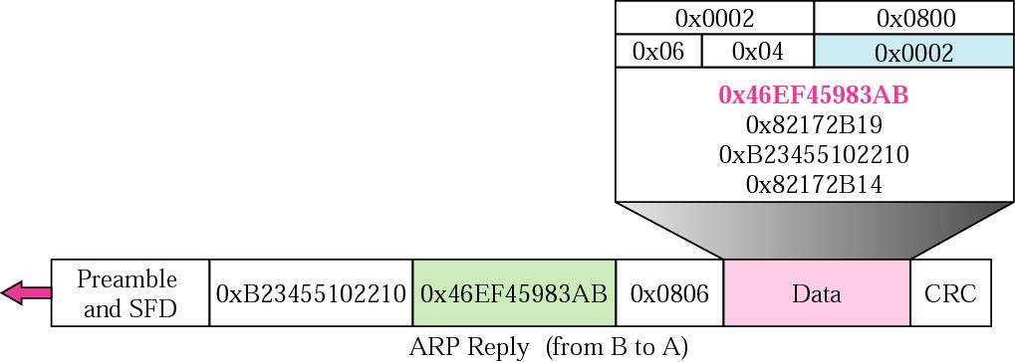
Example 1 (Continued)
F
igure 7-7: reply
The McGraw-Hill Companies, Inc., 2000
PDF created with FinePrint pdfFactory Pro trial version www.pdffactory.com

Slide 33
Proxy ARP
Used to create a subnetting effect
A router running a proxy ARP
Its ARP acts on behalf of a set of hosts
If it receives an ARP request message looking for the address of one of these host
The router sends an ARP reply announcing its own hardware (physical) address
After the router receives the actual IP packet
It sends the packet to the appropriate host or router
PDF created with FinePrint pdfFactory Pro trial version www.pdffactory.com

Slide 34
Example
Administrator need to create a subnet without changing the whole system
Add a router running a proxy ARP
PDF created with FinePrint pdfFactory Pro trial version www.pdffactory.com

Slide 35
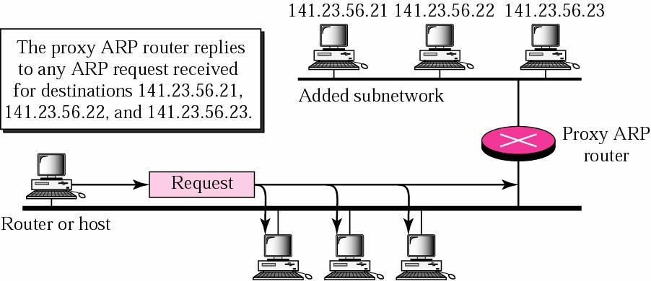
Proxy ARP
F
igure 7-8
The McGraw-Hill Companies, Inc., 2000
PDF created with FinePrint pdfFactory Pro trial version www.pdffactory.com

Slide 36
7.3
RARP
The McGraw-Hill Companies, Inc., 2000
PDF created with FinePrint pdfFactory Pro trial version www.pdffactory.com

Slide 37
RARP
A diskless machine is usually booted from ROM
It cannot include the IP address
IP address are assigned by the network administrator
Obtain its logical address by the physical address using the RARP protocol
PDF created with FinePrint pdfFactory Pro trial version www.pdffactory.com

Slide 38
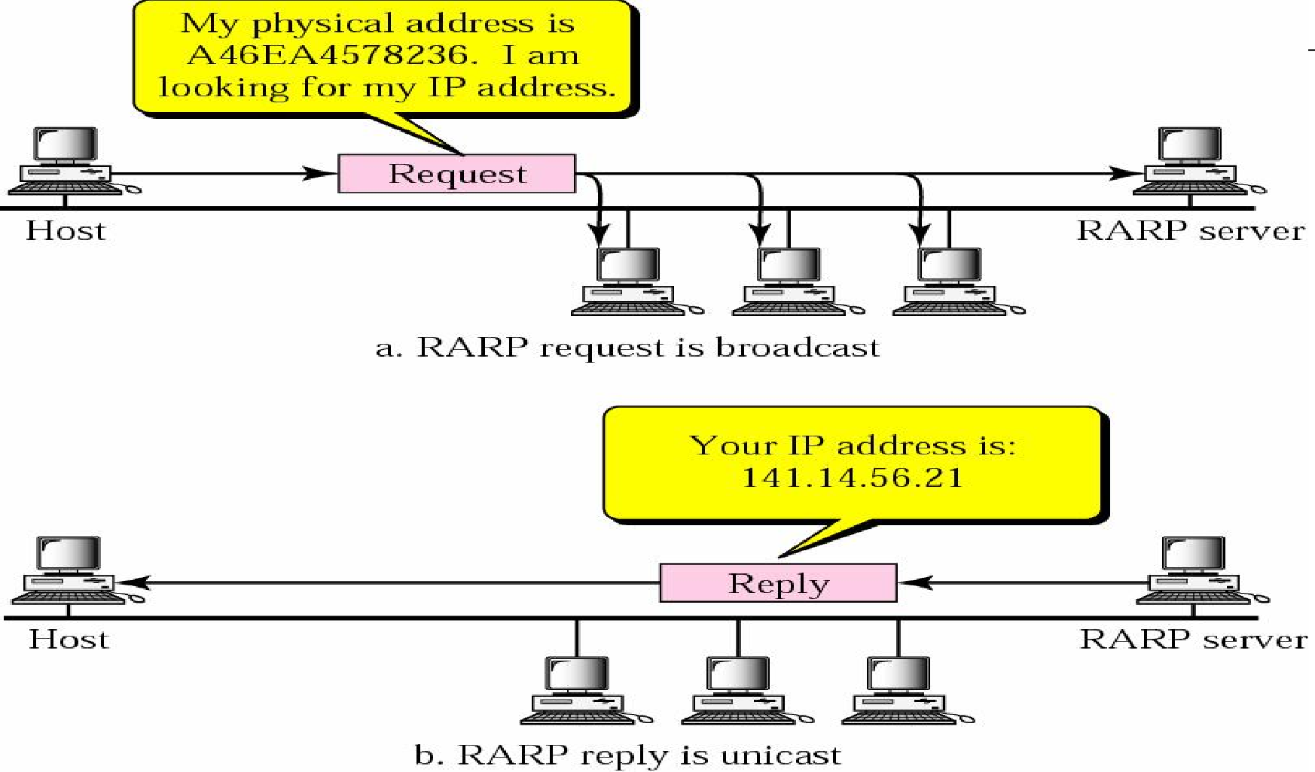
RARP Operation
F
igure 7-10
The McGraw-Hill Companies, Inc., 2000
PDF created with FinePrint pdfFactory Pro trial version www.pdffactory.com

Slide 39
The RARP request packets are broadcast;
the RARP reply packets are unicast.
The McGraw-Hill Companies, Inc., 2000
PDF created with FinePrint pdfFactory Pro trial version www.pdffactory.com

Slide 40
Packet Format
The format of the RARP packet is the same as the ARP packet
Except that the operation field is
Three for RARP request message
Four for RARP reply message
PDF created with FinePrint pdfFactory Pro trial version www.pdffactory.com

Slide 41
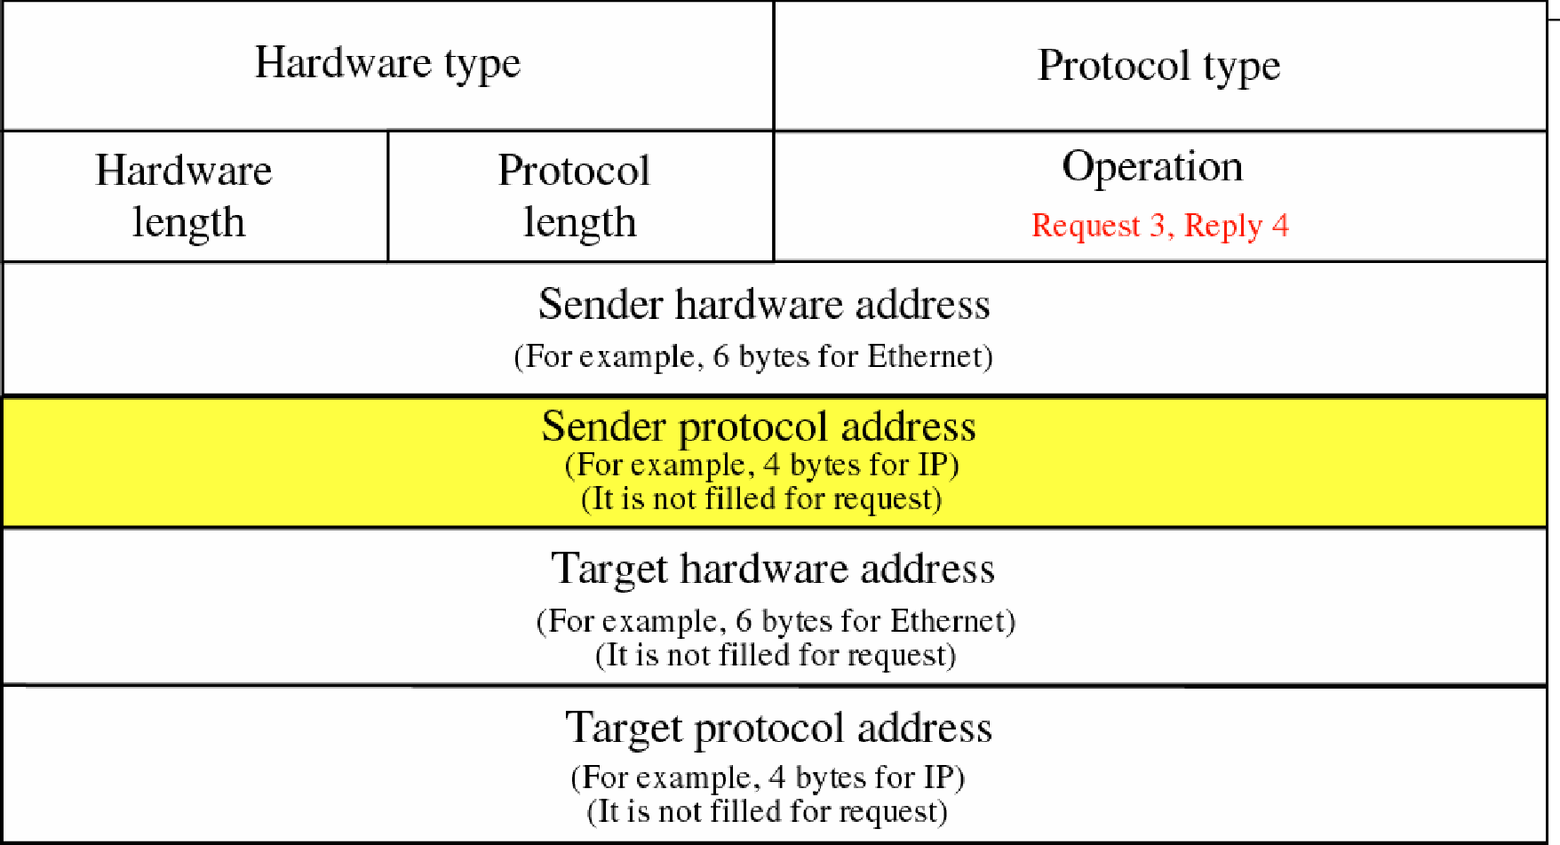
RARP Packet
F
igure 7-11
The McGraw-Hill Companies, Inc., 2000
PDF created with FinePrint pdfFactory Pro trial version www.pdffactory.com

Slide 42
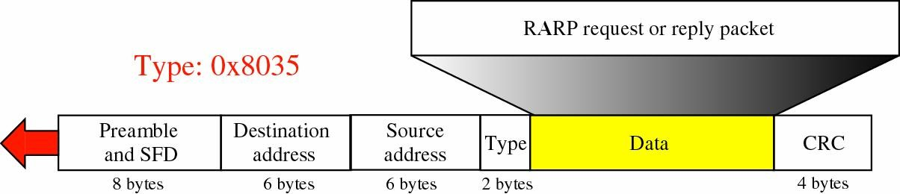
Encapsulation of RARP Packet
F
igure 7-12
The McGraw-Hill Companies, Inc., 2000
PDF created with FinePrint pdfFactory Pro trial version www.pdffactory.com

Slide 43
Alternative Solutions to RARP
When a diskless computer is booted, it needs more information in addition to its IP address
The subnet mask
The IP address of a router
The IP address of a name server
RARP cannot provide this extra information
Two protocols, BOOTP and DHCP, can be used instead of RARP
PDF created with FinePrint pdfFactory Pro trial version www.pdffactory.com

